Slide 1
IST 707 Group Project
Kent Roller, Kevin Hansen, Ben Tisinger

Slide 2
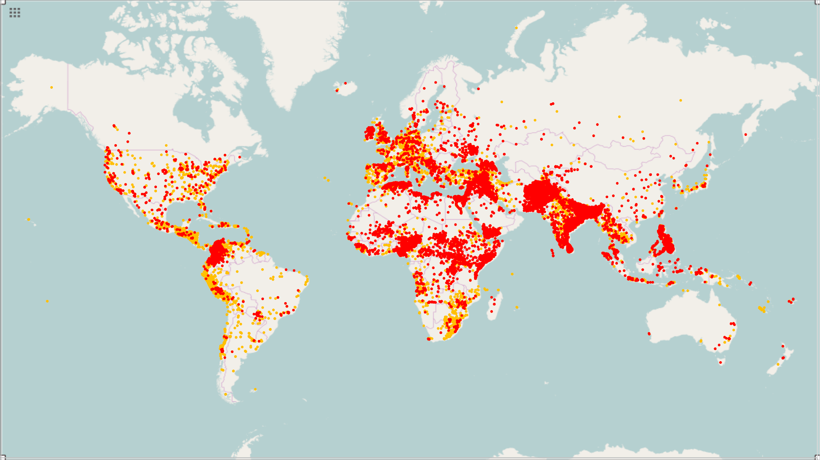
Data Set
Global Terroism Database - Kaggle
This is a database of over 170+ global terrorist attacks that occured during 1970-2016. Many of the columns have been reworked and altered to create a streamlined version. There are over 58 Columns of information.
Main Table:
Global_Terrorism_MDB
Columns Include:
EventID
YearID
Country
Latitude
Longitude
Summary
AttackType
Motive
WeapType
CompClaim

Slide 3
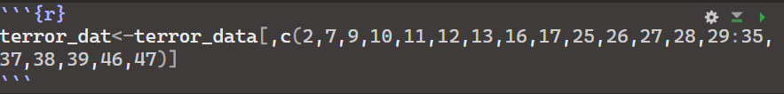
Code Clean Steps
Steps Included:
The initial terrorism dataset included many variables not required for the analysis intended to be performed.
The revised terror dataset cuts the original 58 variable dataset down to 29.

Slide 4
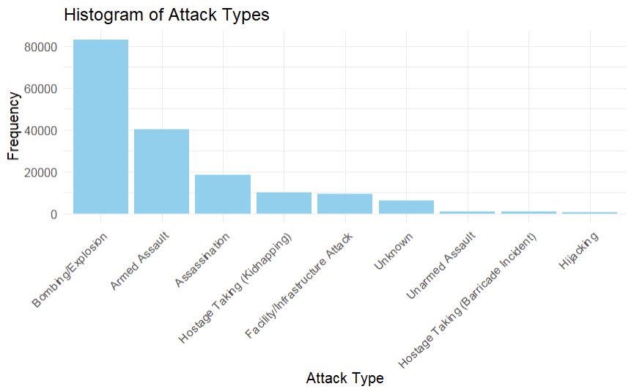
Exploratory Analysis
A histogram of the attack types stored in the database, bombings and explosions are the most common form of terrorist attack.

Slide 5
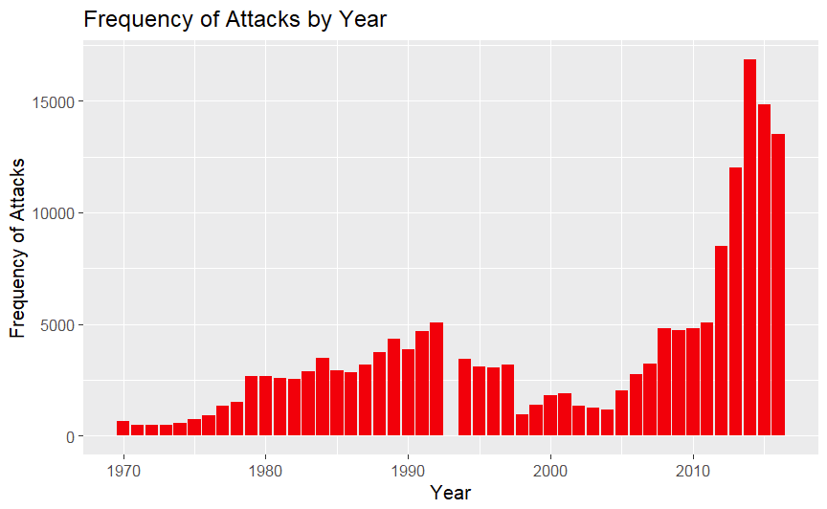
Exploratory Analysis II
The histogram displays the frequency of attacks over the years ranging from 1970 to 2016, where a very noticeable uptick in frequency has occurred since ~2005.

Slide 6
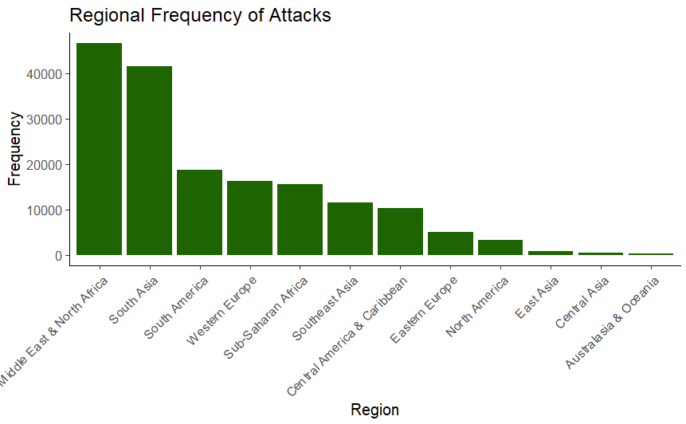
Exploratory Analysis III
The histogram displays the frequency of attacks subdivided by region. The Middle East & North Africa being the area with the highest frequency, followed closely by South Asia.

Slide 7
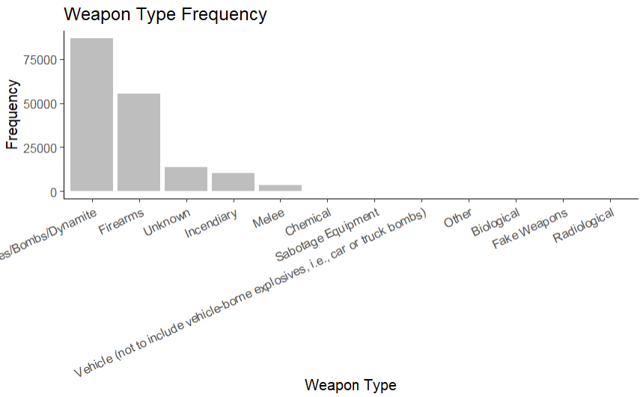
Exploratory Analysis IV
Unsurprisingly, the weapons type reflects the attack type, where Explosives/Bombs are the most frequently used weapon, which makes sense since they are the most common attack type.

Slide 8
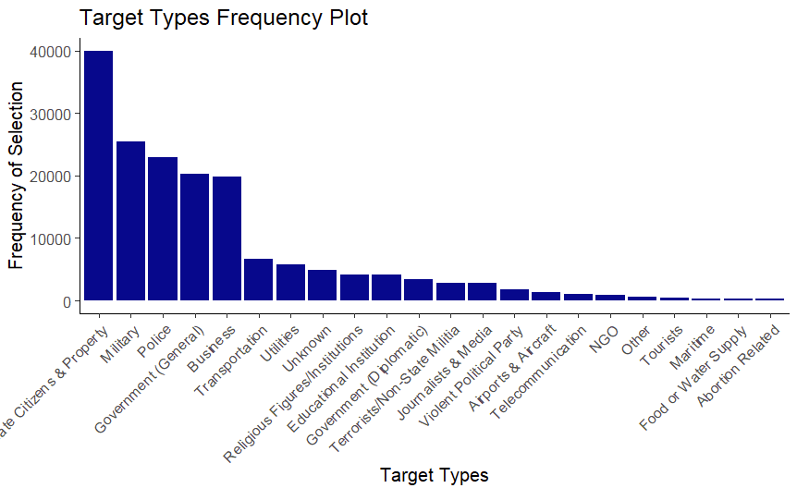
Exploratory Analysis V
The figure shows the most frequently attacked target types. Unsurprisingly, attacks on Private Citizens and Private property exceed those made on Military targets, as most terrorist attacks are targeting “soft” targets. .

Slide 9
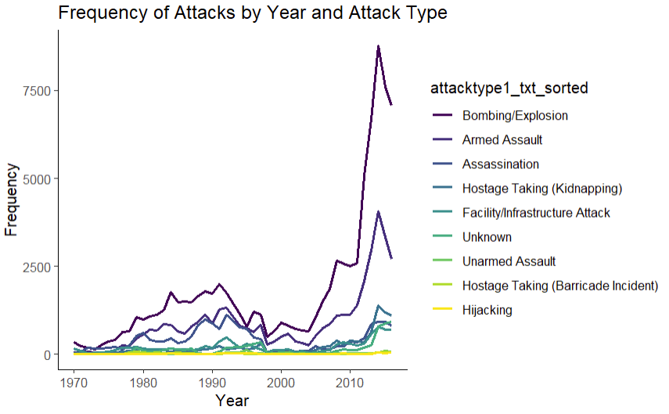
Exploratory Analysis VI
The figure above displays the frequency of attacks based on year of occurrence. As expected Bombing\Explosions show to be a time proven favorite. Though armed assault and kidnappings have increased sharply since 2000 and 2012 respectively.

Slide 10
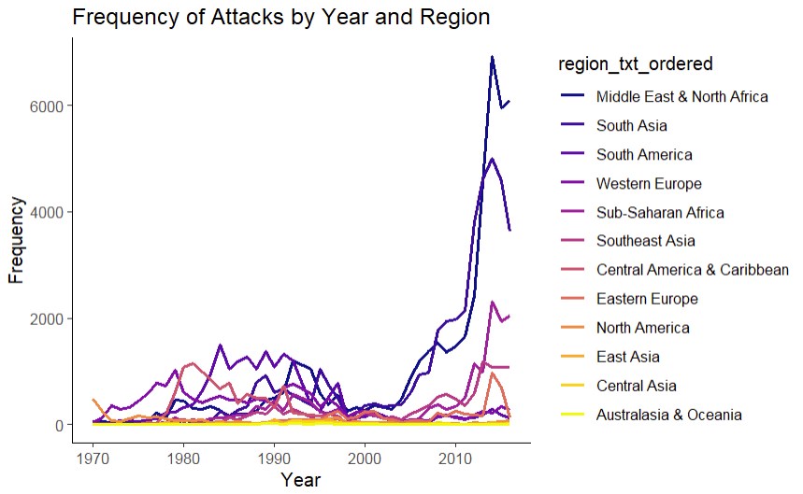
Exploratory Analysis VII
The plot displays the frequency of attacks over the years by region. Interestingly there seems to have been a worldwide reduction ~1998, and then a sharp increase in the mid-2000s.

Slide 11
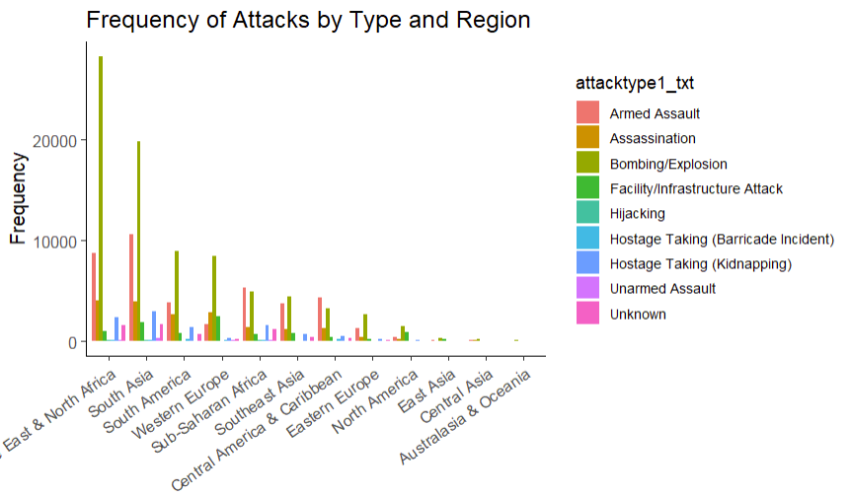
Exploratory Analysis VIII
Frequency of attack types subdivided by region. Displays which attack types are most frequent in each of the regions.

Slide 17
Thank You. That is the End of the Presentation
Any Questions?

